Slide 1
A Note for those Stumbling on these Slides (Hi!)
These lecture slides are not intended as written reference materials.
Just reading them probably won’t be very educational.
Best used in combination with webcasts and source code references.
See (Video) and (Code) links under each lecture: http://datastructur.es

Slide 2
Announcement
If you want to chat after lecture, meet me in the lobby, don’t climb on the stage, they will be mad. Also the Kronos Quartet’s stuff could get destroyed and they have lawyers and deep seething anger for youth (I made that last part up).

Slide 3

CS61B: 2019
Lecture 1:
Introduction
Course Logistics
Hello World

Slide 4
61B Overview
What is 61B about?
Writing code that runs efficiently.
Good algorithms.
Good data structures.
Writing code efficiently.
Designing, building, testing, and debugging large programs.
Use of programming tools.
git, IntelliJ, JUnit, and various command line tools.
Java (not the focus of the course!)
Assumes solid foundation in programming fundamentals, including:
Object oriented programming, recursion, lists, and trees.

Slide 5
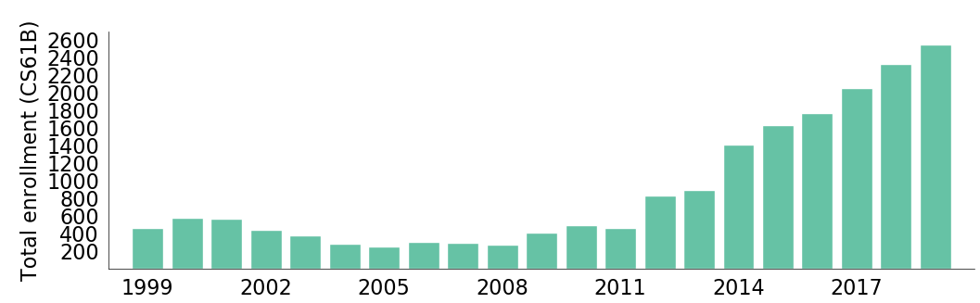
Why Study Algorithms or Data Structures?
Sp19

Slide 6
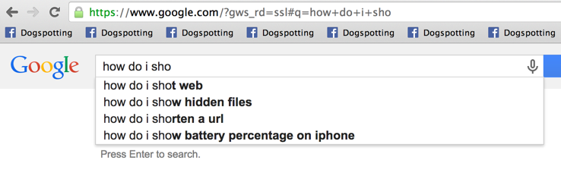
Why Study Algorithms or Data Structures?
Daily life is supported by them.

Slide 7
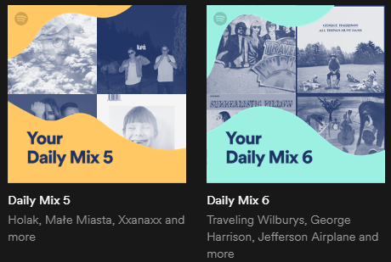
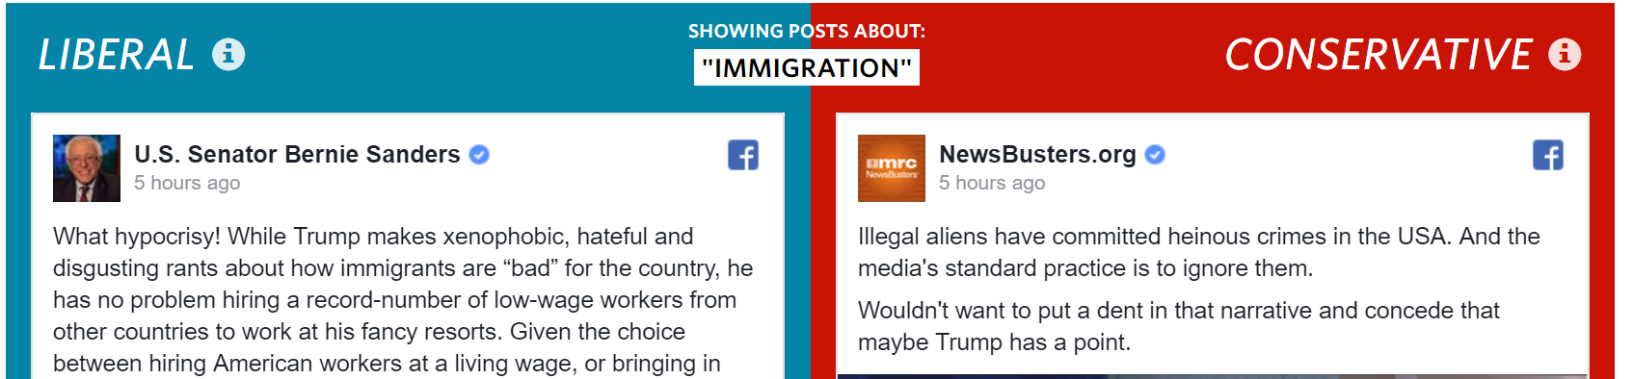
Why Study Algorithms or Data Structures?
Daily life is supported by them.

Slide 8
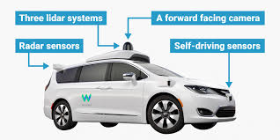
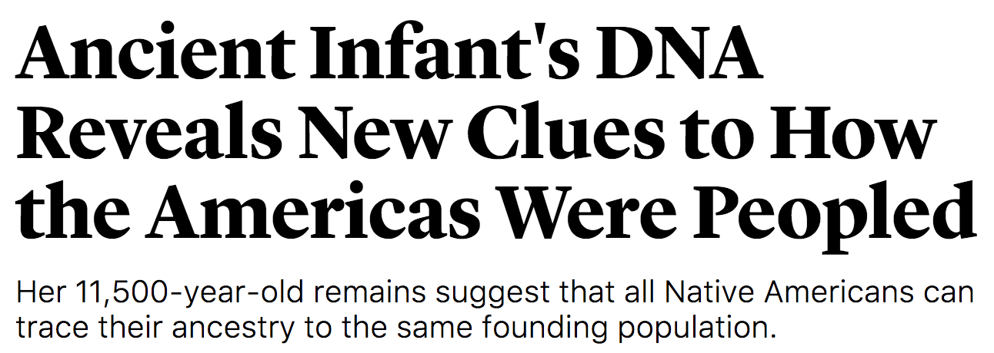

Why Study Algorithms or Data Structures?
Major driver of current progress (?) of our civilization.
Notes:
http://www.businessinsider.com/how-does-googles-waymo-self-driving-car-work-graphic-2017-1

Slide 9
Why Study Algorithms or Data Structures?
To become a better programmer.
Being an efficient programmer means using the right data structures and algorithms for the job.
“The difference between a bad programmer and a good one is whether [the programmer] considers code or data structures more important. Bad programmers worry about the code. Good programmers worry about data structures and their relationships.” - Linus Torvalds (Creator of Linux)

Slide 10
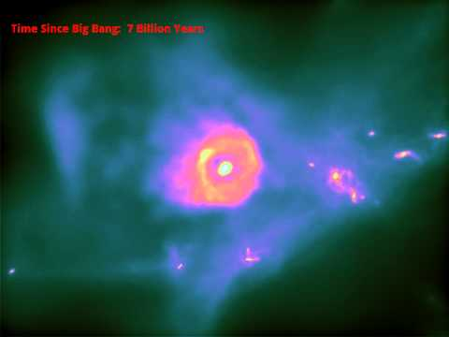
Why Study Algorithms or Data Structures?
To understand the universe. Science is increasingly about simulation and complex data analysis rather than simple observations and clean equations:

Slide 11



Why Study Algorithms or Data Structures?
to
create
beautiful
things

Slide 12
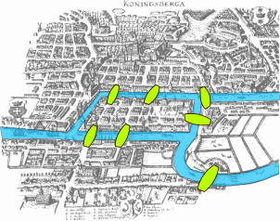

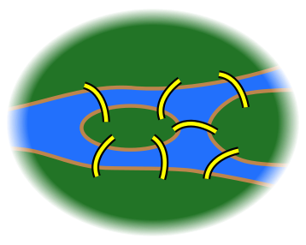
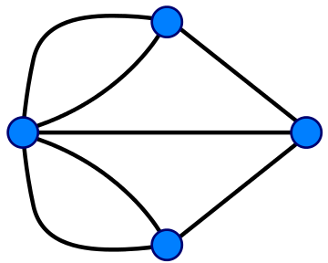
Why Study Algorithms or Data Structures?
As an end unto itself.
Possible to draw without picking up pencil or going back over any lines.
Impossible.
Notes:
http://members.ozemail.com.au/~macinnis/scifun/house.gif
Euler path: Must have exactly zero or two nodes of odd degree.

Slide 13
Question for You
What do you hope / expect to learn from this class? Why are you taking it?
Google/Tesla interview questions.
Getting better at programming.
What is “computer science”? Comptology.
I have to - to declare my major: Data Science.
Understand the memes on the meme page.

Slide 14
Who Are You?
Notes:
Freshman? Sophomore? Junior? Senior? Grad student? None of the above?
CS Major? Intending to be a CS Major? Something else?
61A? Java experience?

Slide 15
Who Are We?
Instructor: Josh Hug (me) hug@cs.berkeley.edu 779 Soda
GSIs:
Part time: Angela Kwon, Annie Huang, Brandon Fong, Carlo Cruz-Albrecht, Catherine Cang, Charles Hager, Ellin Zhao, Erica Kong, Itai Smith, Jennifer Liu, Jeremy Dong, Jihan Yin, Julian Kung, Julianna White, Kartik Kapur, Kelly Lin, Kevin Chang, Lauren Hong, Lucas Pan, Michael Lum, Michael Meng, Neil Kulkarni, Nicholas Titterton, Omar Khan, Riley Woo, Shreya Sahoo, Shubham Gupta, Tina Zhao, Vibha Seshadri
Full time: Albert Hu, Brandon Lee, Catherine Han, Christine Zhou, Danny Chu, Eli Lipsitz, Gigi Lu, Jackson Leisure, Jenny Huang, Joe Deatrick, Josh Zeitsoff, Matt Owen, Matthew Sit, Michelle Hwang, Mudit Gupta, Rahul Nangia, Sam Zhou, Sandra Hui, Sandy Zhang, Ting Ding

Slide 16
Who Are We (continued)?
Tutors: Aakash Shukla, Ajuney Hora, Akshit Annadi, Alan Ton, Alex Kassil, Anirvin Sikha, Anson Tsai, Arjun Sahai, Darren Huang, Emily Zhong, George Zhou, Hannah Yan, Joshua Yang, Mahesh Murag, Megan Kawakami, Mounica Putrevu, Nathan Miller, Noah Kuo, Oscar Ortega, Ramsey Mardini, Rene Lee, Ryan Nuqui, Ryan Tran, Ryan Tseng, Shriya Vohra, Shubha Jagannatha, Uma Krishnan, Yiling Kao

Slide 17
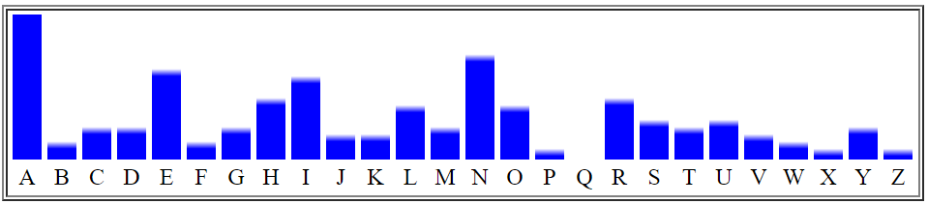
Who Are We (continued)?
Academic interns: Kevin Ko, Jeffrey Hong, Andrew Wang, Amol Pant, Ju Sheen Kim, Amanuel Yitbarek, Dylan Tran, Richard Huang, Apoorva Prakash, Ethan Yeh, Ziqi Jin, Ikram Magzoub, Mher Torjyan, Ruhi Pudipeddi, Kelvin Ngo, Edmund Wang, John Siano, Alejandro A. Stefan Zavala, Prom Putthisri, Cliff Liu, Prateek Kher, Vlad Korsunenko, Stefano Colmignoli, Youqi Chen, Adya Putra Indera, Jie Chen, Ryan Lee, Emily Wang, John Markham, Alex Schedel, Arjun R Bharat, Harim Lee, Harry Song, Jun Jeon, Frederick Fan, Sean Lam, Jacqueline Chu, Connor Lafferty, Howard Ho, Sanchit Kapoor, Kunal Agarwal, Alice Lyu, Michael Chang, Haiwei Zhen, Monica Tang, Cindy Liu, Jiekun Liang, Yuanzhe Ying (Cody), Kevin Li, Ahir Datta, Salman Ahmad, Shivani Prabala, Caleb Kahookele, Amy Wang, Edward Sun, Emanuel Rew, Tarsus Lam, Ashwin Shanker, Soumya Avva, Tammy Truong, Eric Chen, Vatsal Bajaj, Jenny Song , Daniel Fan, Jason Kim, Benson Yuan, Jenna Dorse, Manula Dombagahawatta, Cheenar Gupte, Richard Padilla, David Ruan, Yash Vanvari, Winnie Zhang, Alfredo Andere V., Henry Leou, Asad Abbasi, Tianhao Chen, Yibin Li, Guoxin Yu, Karan Shah, Fei Cong, Brian Fu, Vikram Chandran, Juan Ramon Cai, Eric Ortiz, Eric Gan, Aleksander Petuskey, Yuan Xie, Devesh Rai, Felix Li, Alan Zhou, Theo Luan, Alex Cui, Kathleen Chang, Amitav Baruah, Kevin Nguyen, Yifan Zhang, Jesse Chen, Amy Hung, Akash Singhal, Nikhil Jain, Catherine Chi, Jonathan Pan, Yafei Liang, Carolyn Wang, Claire Ko, Octavian Sima, Xu Huang, Joshua Chen, Borhan Rafiq, Khoa Hoang, Joshua Samuel, Jerry Gong, Timothy Lee, Dilan Bhalla, Ryan Van, James Li, Jerome Wei, Willis Wang, Nicholas Li, Christine Luo, Calvin Chen, Shein Lin Phyo, Jaslyn Avila, John Lichtenberg, Won Ryu, Samarth Venkatasubramaniam, Kathy Li, Erica Grunfeld, Jacky Chow, Charlie Tian, Renhua Liu, George Wu, Raguvir Kunani, Fatema Yasini, Sreyas Narayanan, Evan Mei, Olivia Lee, Alexia Colmenero, Jimmy Xu, Dustin Chen, Yongming Ge, Auni Bagchi, Daniel Lujan, Woojin Ko, Devesh Agarwal, Ahmad Maarouf, Soung Bae Kim, Calvin Kwon, Zijin Cui, Lam Pham, Shahzar Rizvi, Ann Yoo Abbott, Vidhi Chander, Yiming Yang, Dylan Buer, Annie Wong, Shahroze Ranjha, Katniss Lee, Dave Kwon, William Tong, Eugene Lee, Beatriz Israde
Lab assistant letter distributions as generated by:
https://www.mtholyoke.edu/courses/quenell/s2003/ma139/js/count.html

Slide 18
Learning Philosophy

Slide 19
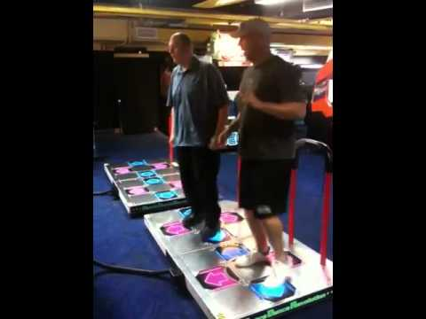

The Manner in Which Learning Occurs (TMWLO)
Notes:
12 minutes to reach this point (16 with new stuff)

Slide 20
TMWLO: A Small Minority
Lectures
Introduction to new material.
Reading
More thorough introduction.

Slide 21
TMWLO: The Vast Majority
Discussion Section and Study Guides:
Practice with concepts. Often more theoretical.
Labs, Homework, and Your Own Experimentation
Practice with tools, programming techniques, Java syntax, and algorithms and data structures.
Projects
Similar to labs and HW, but larger and include a design component.

Slide 22
Course Logistics

Slide 23
Places to Get Information
Official Course Resources
Course website: http://datastructur.es
Lectures (or webcasts). Discussion. Lab. Office Hours (starting next week, times and locations TBA).
Piazza: http://piazza.com/class/61b
Mini-Textbook: Obscurantism in Java https://joshhug.gitbooks.io/obscurantism-in-java-first-edition
5 student Group Tutoring Sections (starting week 3?).
Unofficial: Google, Stack Overflow, other programming courses on the web, various online documentation, etc.

Slide 24
Logistical Details
For waitlisted folks: If you do project 0, I’ll do what I can to get you in by week 4, but no guarantees.
Unlike past semesters, there is a chance we might not be able to accommodate everyone! Demand is much higher than expected.
Sp17: 1379 students, Sp18: 1420, Sp19: 1646
Week 1 sections and labs are first-come, first-served. See piazza post here: https://piazza.com/class/jqr7hfmf4v74e?cid=73
Once attendance settles, doesn’t matter which lab/section/lecture you’re registered for.
Please post administrative issues to Piazza or send an email to cs61b@berkeley.edu
Please don’t email me with such issues directly (sorry!).
1650 students * 1 minute/student = 27.5 hours.

Slide 25
61B 3.0 - Course Structure
Phase 1: Programming Intensive Introduction to Java.
Weeks 1-4.
One browser-based programming HW (this HW0 is optional).
Three labs to introduce you to various tools (starting this week).
Two projects (proj0 and proj1).
Midterm 2/20 at 8:00 PM.

Slide 26
61B 3.0 - Course Structure
Phase 2: Data Structures.
Weeks 5-10.
Incredibly important and foundational material: Expect an CS job interview to lean heavily on this part of the course.
Two medium sized HWs (HW1, HW2) and one small HW (HW3).
Applications and deeper insight into data structures.
One large project (Proj2A/2B), due ~3/18 and ~3/22.
No autograder. You’re responsible for your code’s correctness.
Standard labs implement data structures (e.g. hash table).
Challenge labs are more like hard puzzles using data structures.
Midterm 4/5 at 8:00 PM.

Slide 27
61B 3.0 - Course Structure
Phase 3: Algorithms and Software Engineering
Weeks 10-14
Labs: Implement a basic algorithm (e.g. quicksort).
Challenge labs: Hard data structures / algorithmic puzzles.
One medium sized HW: Implement an AI that solves problems using A* algorithm.
Two projects:
Proj2C: BearMaps. Uses data structures from Proj2A/2B and algorithm from HW4 to implement a browser-based mapping application.
Proj 3: Build Your Own World: An open ended project where you build a 2D world with physics according to your own design.
See calendar at http://datastructur.es for more.

Slide 28
Labs and Discussion
Attendance for lab/discussion is not required, but can earn “pacing points” by attending discussion or lab.
See course website for details on pacing points.
tl;dr is that they can help you get up to a B-, but don’t help beyond that.
Labs:
Lab always due by Friday at 11:59 PM. Full credit for ‘reasonable effort’.

Slide 29
HWs and Projects
4 homeworks.
Due dates vary widely, see calendar.
Projects:
Projects 1 and 2 must be done solo. 0 and 3 can be done as a pair.
Projects 2 and 3 will be really time consuming and difficult.
All code on solo projects must be your own work.
Ok to discuss with others and help debug.
Extra credit opportunities on projects 2 and 3 for finishing early.
Can earn gold points on projects for going above and beyond.
Gold points are special points whose value is worth more if your exam scores are lower. See course website for full details.

Slide 30

Weekly Surveys and Study Guides
Weekly survey due every Sunday.
Check in on your progress and report attendance.
Free points, but no late submissions allowed!
Lowest four dropped.
Study guides for each lecture.
HWs will not prepare you directly for many types of exam problems.
Use these study guides instead!
Provides a brief summary of the lecture.
Provides (usually) C level, B level, and A level problems for exam studying.
A level problems are usually hard enough that I anticipate TAs will have a hard time with them, so be nice!

Slide 31
Exams
Closed note except you can bring cheat sheets.
Will be pretty hard (60% medians).
Showing improvement on final can boost overall exam score.
If your final is statistically better, it can replace one of your two midterms. See “supersession” under course website for details.
Exam dates:
Midterm 1: February 20th, 8:00 -10:00 PM.
Midterm 2: April 5th, 8:00 - 10:00 PM.
Final Exam: May 15th, 7:00 - 10:00 PM.
There will be no alternate exams (see exam replacement policy).
One exception: Direct conflict with a final from another class.

Slide 32
Course Grade
Breakdown: 3,152 points total. Letter grade will be determined by your total.
Midterms: 800 points total.
Final: 800 points.
Projects: 960 regular points.
HW: 320 points (80 points each)
Lab: 192 points (16 points each)
Weekly Surveys: 80 points (8 points each)
Grades are not curved, i.e. they are not based on your relative performance. In past semesters, my grade bin cutoffs have not moved much at all.
See http://sp19.datastructur.es/about.html for full details including grading bin cutoffs.
Plus extra credit for filling out pre-, mid-, and post- semester course surveys, also for turning in projects 2 and 3 early.
Plus gold points for going above and beyond on projects.
Notes:
26 minutes

Slide 33
Lateness and Mentor GSIs
No late work will be accepted in the course. No hws/labs/projects are dropped.
You should treat the deadlines seriously!
Use automated extension system to request extensions in advance.
It will give a small number of extensions (details will not be divulged).
Once you exceed these, you’ll need to talk to your Mentor GSI.
“In advance” means any time before deadline.
During week 2, you will be pick a mentor GSI.
If you do not pick one, one will be assigned for you.
Mentor GSI will keep track of your progress and reach out (or have someone else reach out) if they feel like there are potential issues.
If automated system rejects extensions, you must ask your mentor GSI.

Slide 34
Course Pacing
We will start off very fast.
Optional HW0 is out.
Intro to Java syntax.
Will take 1-4 hours.
Work with friends!
Recommended that you complete before your lab.
Strongly recommended that you complete by lecture Friday.
Lab1 and Lab1 Setup are both available.
Lab1: How to use various tools.
Lab1 Setup: How to set up your home computer (maybe do before lab1).
Project 0 released 1/23. Due Friday Feb 1st (10 days from start of semester).
Start by Saturday if possible, especially if you’re new to Java.
Exercises all the basic Java features.
Allowed to work in pairs (more in lecture next time or see proj0 spec).

Slide 35
Hello World
(See guide for link to the code I write today)
(Might be a little boring if you know Java already)

Slide 36
Java and Object Orientation
Java is an object oriented language with strict requirements:
Every Java file must contain a class declaration*.
All code lives inside a class*, even helper functions, global constants, etc.
To run a Java program, you typically define a main method using public static void main(String[] args)
*: This is not completely true, e.g. we can also declare “interfaces” in .java files that may contain code. We’ll cover these later.

Slide 37
Java and Static Typing
Java is statically typed!
All variables, parameters, and methods must have a declared type.
That type can never change.
Expressions also have a type, e.g. “larger(5, 10) + 3” has type int.
The compiler checks that all the types in your program are compatible before the program ever runs!
e.g. String x = larger(5, 10) + 3 will fail to compile.
This is unlike a language like Python, where type checks are performed DURING execution.

Slide 38
Your Reflections on Static Typing
The Good:
Easier to follow what the code does!!
It lets you catch one type of mistake beforehand.
Customers never see type erorrs.
You the programmer immediately catch one type of error.
More efficient under the hood.
The Bad:
Tedious!
tHE CODE IS MOST verbose
Code is less general and making it general takes lots more code.

Slide 39
What’s Next
This week:
HW0: Out now. Will give you a chance to explore Java basics on your own.
Lab1: How to compile and run code on the lab machines. How to check out homework starter files and submit them. If possible, do HW0 before lab!
Lab1 Setup (optional): How to compile and run code on your own machine.
Project 0 (just released). Only two types of partnerships allowed:
Both partners have taken a Java class.
Neither partner has taken a Java class.
No mixed groups.
Next lecture: What all that public static blah blah stuff actually means.

Slide 40
Course Logistics (Full Version)

Slide 41
Places to Get Information
Official Course Resources
Course website: http://datastructur.es
Lectures (or webcasts).
Piazza: http://piazza.com/class/61b
Office hours (locations and times TBA).
Lab (ok to discuss anything, even topics unrelated to that day’s lab).
Discussion.
Homework Parties.
5 student Group Tutoring Sections.
Mini-Textbook: Working title is just Hug61B for now: http://gitbook.com/book/joshhug/hug61b
Unofficial: Google, Stack Overflow, other programming courses on the web, various online documentation, etc.

Slide 42
Logistical Details
For waitlisted folks: If you do project 0, I’ll do what I can to get you in by week 4.
If possible, go to your assigned section and lab this week.
If you don’t have one yet, go to any section or lab.
If room is too full, priority goes to those officially registered.
Not registered? Please wait outside until 2 minutes before start (XX:08).
Once attendance settles, doesn’t matter which lab/section/lecture you’re registered for.
Please post administrative issues to Piazza or send an email to cs61b@berkeley.edu
Please don’t email me directly (sorry!).
1400 students * 1 minute/student = 24.2 hours.

Slide 43
61B 2.5 - Course Structure
Phase 1: Programming Intensive Introduction to Java.
Weeks 1-4.
One browser-based programming HW (this HW0 is optional).
Three labs to introduce you to various tools (starting this week).
Two projects (proj0 and proj1).
Phase 2: Advanced Programming
Weeks 5-7.
One small HW (HW1).
One large project, due ~3/5.
New: You design your own explorable world (within some constraints).
Labs to support large project.

Slide 44
61B 2.5 - Course Structure
Phase 3: Data Structures and Algorithms
Weeks 8-14
Incredibly important and foundational material: Expect an CS job interview to lean heavily on this part of the course.
Labs: Implement a data structure or algorithm.
Each lab ends with a TA led discussion of best implementation.
Six HWs: Apply a data structure or algorithm toward a real world problem.
Two released during RRR week. Can be used to makeup missed homeworks earlier, or for practice.
One very challenging data structure/algorithms project (but not as big as project 2).
See calendar at http://datastructur.es for more.

Slide 45
Lab Logistics
OK to work on labs ahead of time.
Attendance not required, except for special project labs (more later).
Lab always due by Friday at 11:59 PM.
Full credit for ‘reasonable effort’.
Some labs are freebies (automatic credit, even if you don’t show up).
14 total labs, worth 8 points each [96 points total].
Lowest two are dropped. Intended to cover life difficulties.
No extensions or grace hours except emergencies that make you miss > 2 labs.

Slide 46
Discussion Logistics
Attendance not required, but 2 gold points per discussion you attend (up to a maximum of 20 gold points).
Attendance not officially taken the first two weeks.
What’s a gold point?
Helps boost your score if you don’t do as well as on exams.
The lower your exam score, the more gold points help.
Up to a maximum of counting double if you get a zero on all exams.
Not a good strategy to intentionally get zero points on all exams.
See course info for the full details.

Slide 47
HWs
Homework breakdown:
HW0: Optional browser based Java exercises.
HW1: Practice with advanced Java features.
HW2-7: Applications of various data structures and algorithms.
Due dates vary. See calendar.
7 total required homeworks, worth 32 points each [160 points total].
Lowest two are dropped. Intended to cover life difficulties.
No extensions or grace hours except emergencies that make you miss > 2 labs.

Slide 48
Vitamins and Study Guides (for conceptual understanding)
Each week, there will be a series of exercises (vitamins) for that week’s lectures.
Due on Sunday at 11:59 PM.
Relatively short.
Primarily intended to keep you on track with lectures.
4 points each for 48 points (lowest two of 14 are dropped).
For each lecture, there is also a “study guide”.
Provides a brief summary of the lecture.
Provides (usually) C level, B level, and A level problems for exam studying.
A level problems are usually hard enough that I anticipate TAs will have a hard time with them, so be nice!

Slide 49
Projects
Four projects
One lightweight project, two medium projects, one large project.
Project 0 (solo or pair): 50 points
Project 1 (solo): 80 points
Project 2 (pair): 200 points
Project 3 (solo): 150 points
Projects 2 and 3 will be very time consuming. Plan ahead.
All code on solo projects must be your own work.
Ok to discuss with others and help debug.
Projects 1, 2, and 3 will have extra credit opportunities.
Early submission deadline: Bonus points.
Stretch goals: “Gold” points.

Slide 50
Exams
Exams will be “hard”
Median scores will be lower than you might be used to (ideally ~60%).
Two midterms in evenings, one final exam.
One sheet of paper (front and back) per exam.
If your midterm grades are statistically much worse than your final, we’ll replace your midterm grade. See “supersession” on course info page for the full details.
Exam dates (midterms tentative until room deadlines confirmed):
Midterm 1: February 12th, 8:00 -10:00 PM (drop deadline is February 16th)
Midterm 2: March 20th, 8:00 - 10:00 PM.
May 9th (final exam) at 7 PM.
There will be no alternate exams (see exam replacement policy).

Slide 51
Course Grade
Breakdown: 1,584 points total.
Midterms: 400 points total.
Final: 400 points.
Projects: 480 regular points.
HW: 160 points (32 points each)
Lab: 96 points (8 points each)
Vitamins: 48 points (4 points each)
Grades are not curved, i.e. they are not based on your relative performance. In past semesters, grade bin cutoffs have not budged (or if they did, just barely).
See http://sp18.datastructur.es/about.html for full details including grading bin cutoffs.
Plus occasional opportunities for extra credit for filling out course feedback surveys and projects 1, 2, and 3.
Notes:
26 minutes

Slide 52
Course Pacing
We will start off very fast.
Optional HW0 is out.
Intro to Java syntax.
Will take 1-4 hours.
Work with friends!
Recommended that you complete before your lab.
Strongly recommended that you complete by lecture Friday.
Lab1 and Lab1 Setup are both available.
Lab1: How to use various tools.
Lab1 Setup: How to set up your home computer (maybe do before lab1).
Project 0 released Friday. Due next Friday Jan 26th (10 days from start of semester).
Exercises all the basic Java features.
Allowed to work in pairs (more next time).

Slide 53
Citations
Real-time MRI by the New Scientist: https://www.youtube.com/watch?v=8XQlIvlWqpo
Self-driving car image by The Guardian: http://www.theguardian.com/technology/2014/may/28/google-self-driving-car-how-does-it-work
Dance Dance Revolution videos from:
https://www.youtube.com/watch?v=OVtnnIifaU8
https://www.youtube.com/watch?v=12lSScKSx20

Slide 54
Questions for You [first lecture]
What do you hope / expect to learn from this class? Why are you taking it?
Learn how to organize code to make my life easier.
Get a job with it.
Civlization seems to have gone weird in the west, and if I want to bein hte middle class or higher, being able to program certainly seems useful. Let’s do that. Required for degree.
Need it for major: EECS.
Better understanding of efficiency.
Learn how to build large projects.
Subscribe to my spotify list. To undersatnd the algorithm behind it… this class might be marginally helpful.
Because you can get a job, and then work at Spotify and then learn how it works.

